Slide 1

Computer literacy Program
U.S. Probation Workforce Development TEAM

Slide 2

goal
Basic computer skills are essential for employability and efficiency in today’s workforce. As a part of the Workforce Development Program FY24 Strategic Plan, one goal is to develop an in-district computer literacy program to assist persons under supervision with creating an email address, resume, complete job applications, educational and vocational training applications, and teach Microsoft Office programs. Once officers have identified persons under supervision who could benefit from one or more of these services, officers are encouraged to reserve a laptop.

Slide 3
Procedure for Reserving a Laptop
Send an email request to Taylor_Sevier@ilnp.uscourts.gov and Raven_McMillan@ilnp.uscourts.gov including date(s) needed. (Allow two business days from the date requested to receive the laptop.)
SUSPO Taylor Sevier will deliver the laptop and charging cable.
When the laptop is delivered, the officer will read and sign the terms for reserving the laptop and complete the Laptop Sign Out/In Log.

Slide 4
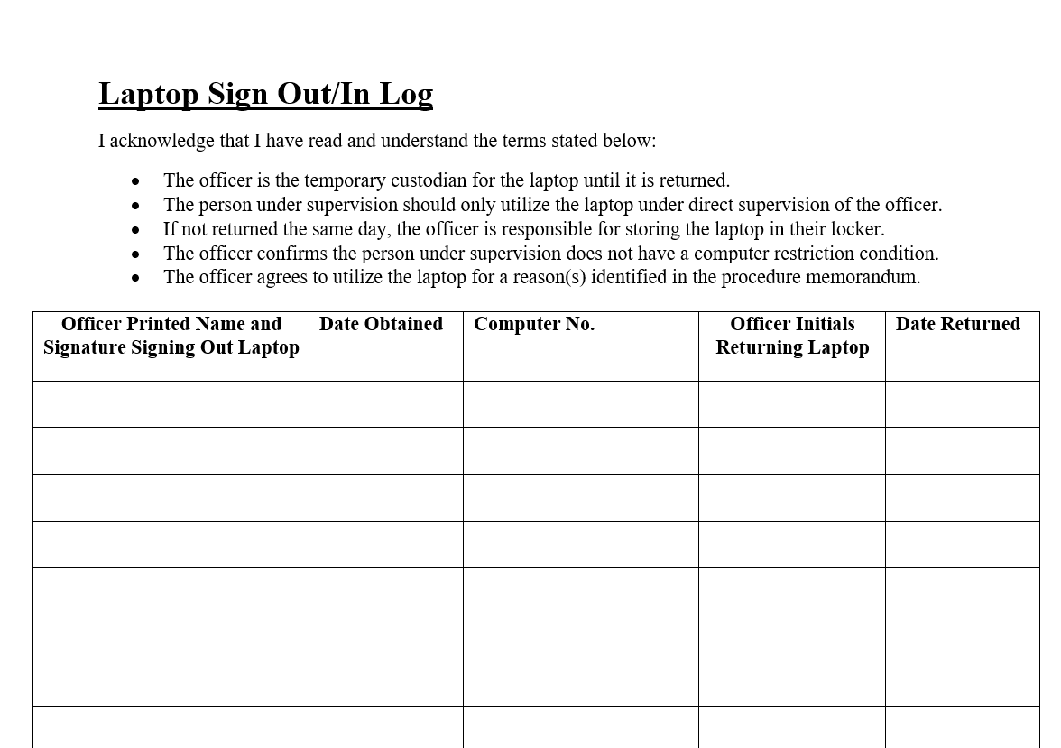

Slide 5
Procedure for Returning
When finished with the laptop, officers will email Taylor and Raven to determine a return date. At return, the officer will initial and date the Laptop Sign Out/In Log.
(If not returned the same day, officers should store the laptop in their locker.)

Slide 7

Questions
Notes:
Any questions?

Slide 8
Computer literacy Program
U.S. Probation Workforce Development

Slide 9

How to set up an email account
Create a Google Account
First/Last Name
Basic Information/Gender
Choose your gmail address or create your own*
Create a strong password
Add recovery email (or skip)
Review your account and agree to the terms
Notes:
https://youtu.be/ZSG6d1p3mJ0?si=Dh7hf0Dcfph5R7JN

Slide 10

Choosing a professional email address
Examples of bad professional email addresses:
Dopeboy1232@gmail.com
Guitarhero1231231231231231232@hotmail.com
Examples of good professional email addresses:
Michael.Jordan@gmail.com
Brittany_Spears@yahoo.com
Sandler.adam@gmail.com

Slide 11

Creating a resume
Microsoft Word
Resume template
Choose chronological or functional resume
Review examples of both resumes
Notes:
Who has a resume? For those who have resumes, are they functional or chronological? Please email your resumes to gmail.com. They will be reviewed, and you will receive feedback on them. For those who do not have a resume, you will use this time to create one.

